Slide 1

Streams
C H A P T E R 4
We will not be satisfied until justice rolls down like waters and righteousness like a mighty stream.
—The Reverend Martin Luther King, Jr., I Have a Dream, August 28, 1963 (paraphrasing Amos 5:24)
4.1 Formatted output
4.2 Formatted input
4.3 Data files
4.4 Class hierarchies
4.5 The simpio.h and filelib.h libraries

Slide 2
Formatted Output
Ever since the very first program in the text, which displayed the message "hello, world" on the screen, you have been using strings to communicate with the user.
Up to now, you have not had any idea how C++ represents strings inside the computer or how you might manipulate the characters that make up a string. At the same time, the fact that you don’t know those things has not compromised your ability to use strings effectively because you have been able to think of strings holistically as if they were a primitive type.
For most applications, the abstract view of strings you have held up to now is precisely the right one. On the inside, strings are surprisingly complicated objects whose details are better left hidden.
C++ supports a high-level view of strings by making string a class whose methods hide the underlying complexity.

Slide 3
The Insertion Operator
The standard technique to specify formatted output in C++ uses the insertion operator, which is written as <<. This operator takes an output stream on the left and an expression of any type on its right. The effect is to write the value of the expression to the output stream using the current format settings.
The insertion operator returns the output stream as its value. The advantage of this interpretation is that output operations can be chained together, as in the following statement:
cout << "The total is " << total << endl;
C++ allows you to control the output by including items in the output chain called manipulators, which affect the way in subsequent values are formatted. A list of the most common output manipulators appears on the next slide.

Slide 4
Output Manipulators
endl
Moves cursor to the next line.
setw(n)
Sets the width of the next value to n characters.
setprecision(digits)
Sets how many digits should appear.
setfill(ch)
Sets the fill character used to pad values.
left
Aligns the value at the left edge of the field.
right
Aligns the value at the right edge of the field.
fixed
Sets fixed-point output (no scientific notation).
scientific
Sets scientific-notation output.
showpoint/noshowpoint
Controls whether a decimal point must appear.
showpos/noshowpos
Controls appearance of a plus sign.
uppercase/nouppercase
Controls whether uppercase is used in hex.
boolalpha/noboolalpha
Controls whether bools appear as true/false.

Slide 5
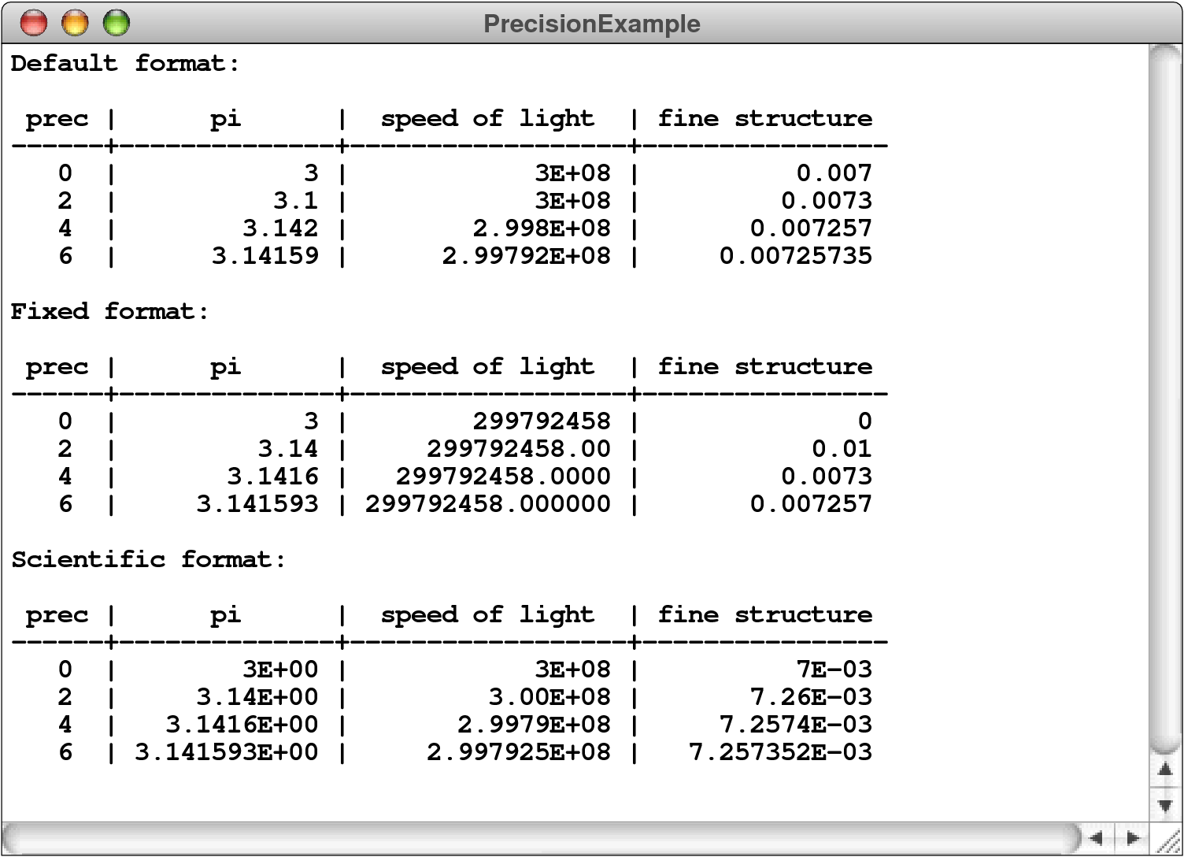
Precision Example

Slide 6
Formatted Input
For input, C++ includes the >> operator, which is called the extraction operator. The >> operator is symmetrical to the << operator and reads formatted data from the stream on the left into the variables that appear on the right.
Up to now, you have not had any idea how C++ represents strings inside the computer or how you might manipulate the characters that make up a string. At the same time, the fact that you don’t know those things has not compromised your ability to use strings effectively because you have been able to think of strings holistically as if they were a primitive type.

Slide 7
Data Files
A file is the generic name for any named collection of data maintained on the various types of permanent storage media attached to a computer. In most cases, a file is stored on a hard disk, but it can also be stored on removable medium, such as a CD or flash memory drive.
Files can contain information of many different types. When you compile a C++ program, for example, the compiler stores its output in an object file containing the binary representation of the program. The most common type of file, however, is a text file, which contains character data of the sort you find in a string.

Slide 8
Text Files vs. Strings
Although text files and strings both contain character data, it is important to keep in mind the following important differences between text files and strings:
1.
The information stored in a file is permanent. The value of a string variable persists only as long as the variable does. Local variables disappear when the method returns, and instance variables disappear when the object goes away, which typically does not occur until the program exits. Information stored in a file exists until the file is deleted.
2.
Files are usually read sequentially. When you read data from a file, you usually start at the beginning and read the characters in order, either individually or in groups that are most commonly individual lines. Once you have read one set of characters, you then move on to the next set of characters until you reach the end of the file.

Slide 9
Using Text Files
When you want to read data from a text file as part of a C++ program, you need to take the following steps:
1.
Construct a new ifstream object that is tied to the data in the file by calling the open method for the stream. This phase of the process is called opening the file. Note that the argument to open is a C string rather than a C++ string.
2.
Call the methods provided by the ifstream class to read data from the file in sequential order. The text of the file can be read in several ways, including character by character or line by line.
3.
Break the association between the reader and the file by calling the stream’s close method, which is called closing the file.

Slide 10
Opening an Input File
/*
* File: filelib.h
* ---------------
* This file exports a standardized set of tools for working with
* files . . .
*/
#ifndef _filelib_h
#define _filelib_h
/*
* Function: promptUserForFile
* Usage: string filename = promptUserForFile(stream, prompt);
* -----------------------------------------------------------
* Asks the user for the name of a file. The file is opened
* using the reference parameter stream, and the function
* returns the name of the file. If the requested file cannot
* be opened, the user is given additional chances to enter a
* valid file. The optional prompt argument provides an input
* prompt for the user.
*/

Slide 11
Opening an Input File
/*
* File: filelib.h
* ---------------
* This file exports a standardized set of tools for working with
* files . . .
*/
#ifndef _filelib_h
#define _filelib_h
/*
* Function: promptUserForFile
* Usage: string filename = promptUserForFile(stream, prompt);
* -----------------------------------------------------------
* Asks the user for the name of a file. The file is opened
* using the reference parameter stream, and the function
* returns the name of the file. If the requested file cannot
* be opened, the user is given additional chances to enter a
* valid file. The optional prompt argument provides an input
* prompt for the user.
*/
string promptUserForFile(ifstream & stream, string prompt) {
while (true) {
cout << prompt;
string filename;
getline(cin, filename);
openFile(stream, filename);
if (!stream.fail()) return filename;
stream.clear();
cout << "Unable to open that file. Try again." << endl;
if (prompt == "") prompt = "Input file: ";
}
}

Slide 12
Reading Characters
You can read characters from an input stream by calling the get method, which comes in two forms:
If you supply no arguments, get() reads and returns the next character value as an int, which is EOF at the end of the file.
If you instead pass a character variable by reference, get(ch) reads the next character into that variable. This form of get returns a value that acts like false at the end of the file.
The second form is less conventional but typically more convenient. The general pattern for reading a stream called infile character by character looks like this:
char ch;
while (infile.get(ch)) {
. . . Perform the necessary operations using the character . . .
}

Slide 13
Reading a File Character by Character
/*
* File: ShowFileContents.cpp
* --------------------------
* This program displays the contents of a file chosen by the user.
*/
#include <iostream>
#include <fstream>
#include <string>
#include "filelib.h"
using namespace std;
int main() {
ifstream infile;
promptUserForFile(infile, "Input file: ");
char ch;
while (infile.get(ch)) {
cout.put(ch);
}
infile.close();
return 0;
}

Slide 14
Reading Lines from a File
You can also read lines from a text file by calling the free function getline, which takes an ifstream and a string as reference parameters. The effect of getline is to store the next line of data from the file into the string variable after discarding the end-of-line character.
If you try to read past the end of the data, getline sets the “fail” indicator, which means that it is interpreted as false.
The following code fragment uses the getline method to determine the length of the longest line in the stream infile:
int max = 0;
string line;
while (getline(infile, line)) {
if (line.length() > max) max = line.length();
}

Slide 15
Reading a File Line by Line
/*
* File: ShowFileContents.cpp
* --------------------------
* This program displays the contents of a file chosen by the user.
*/
#include <iostream>
#include <fstream>
#include <string>
#include "filelib.h"
using namespace std;
int main() {
ifstream infile;
promptUserForFile(infile, "Input file: ");
string line;
while (getline(infile, line)) {
cout << line << endl;
}
infile.close();
return 0;
}

Slide 16
Class Hierarchies
Object-oriented languages are characterized by representing most data structures as objects that encapsulate representation and behavior in a single entity.
The C++ object model is based on the idea of a class, which is a template describing all objects of a particular type. A class definition specifies the representation of the object by naming its fields and the behavior of the object by defining methods. New objects are created as instances of a particular class.
As in most languages, classes in C++ form hierarchies in which subclasses inherit the behavior and representation of their superclass.
Unlike many languages, C++ allows classes to inherit from more than one superclass, which is called multiple inheritance. This technique is easy to abuse and is therefore not discussed until Chapter 19.

Slide 17

Biological Class Hierarchy
Living Things
Kingdom
Plants
Animals
Fungi
Phylum
Annelida
Brachiopoda
Arthropoda
Mollusca
Chordata
Order
Crustacea
Insecta
Arachnida
Class
Hymenoptera
Formicidae
Every black ant is also an animal, an arthropod, and an insect, as well as the other superclasses in the chain.
Family
Classification of the common black ant Lasius niger
Note that there can be many individual black ants, each of which is an instance of the same basic class.
Genus
Lasius
Species
niger

Slide 18
The Stream Hierarchy
ios
istream
ostream
ifstream
istringstream
ofstream
ostringstream

Slide 19
UML Diagram for the Stream Hierarchy
ios
clear()
fail()
eof()
istream
ostream
get()
unget()
>>
put()
<<
ifstream
istringstream
ofstream
ostringstream
open(cstr)
close()
istringstream(s)
open(cstr)
close()
str()

Slide 20
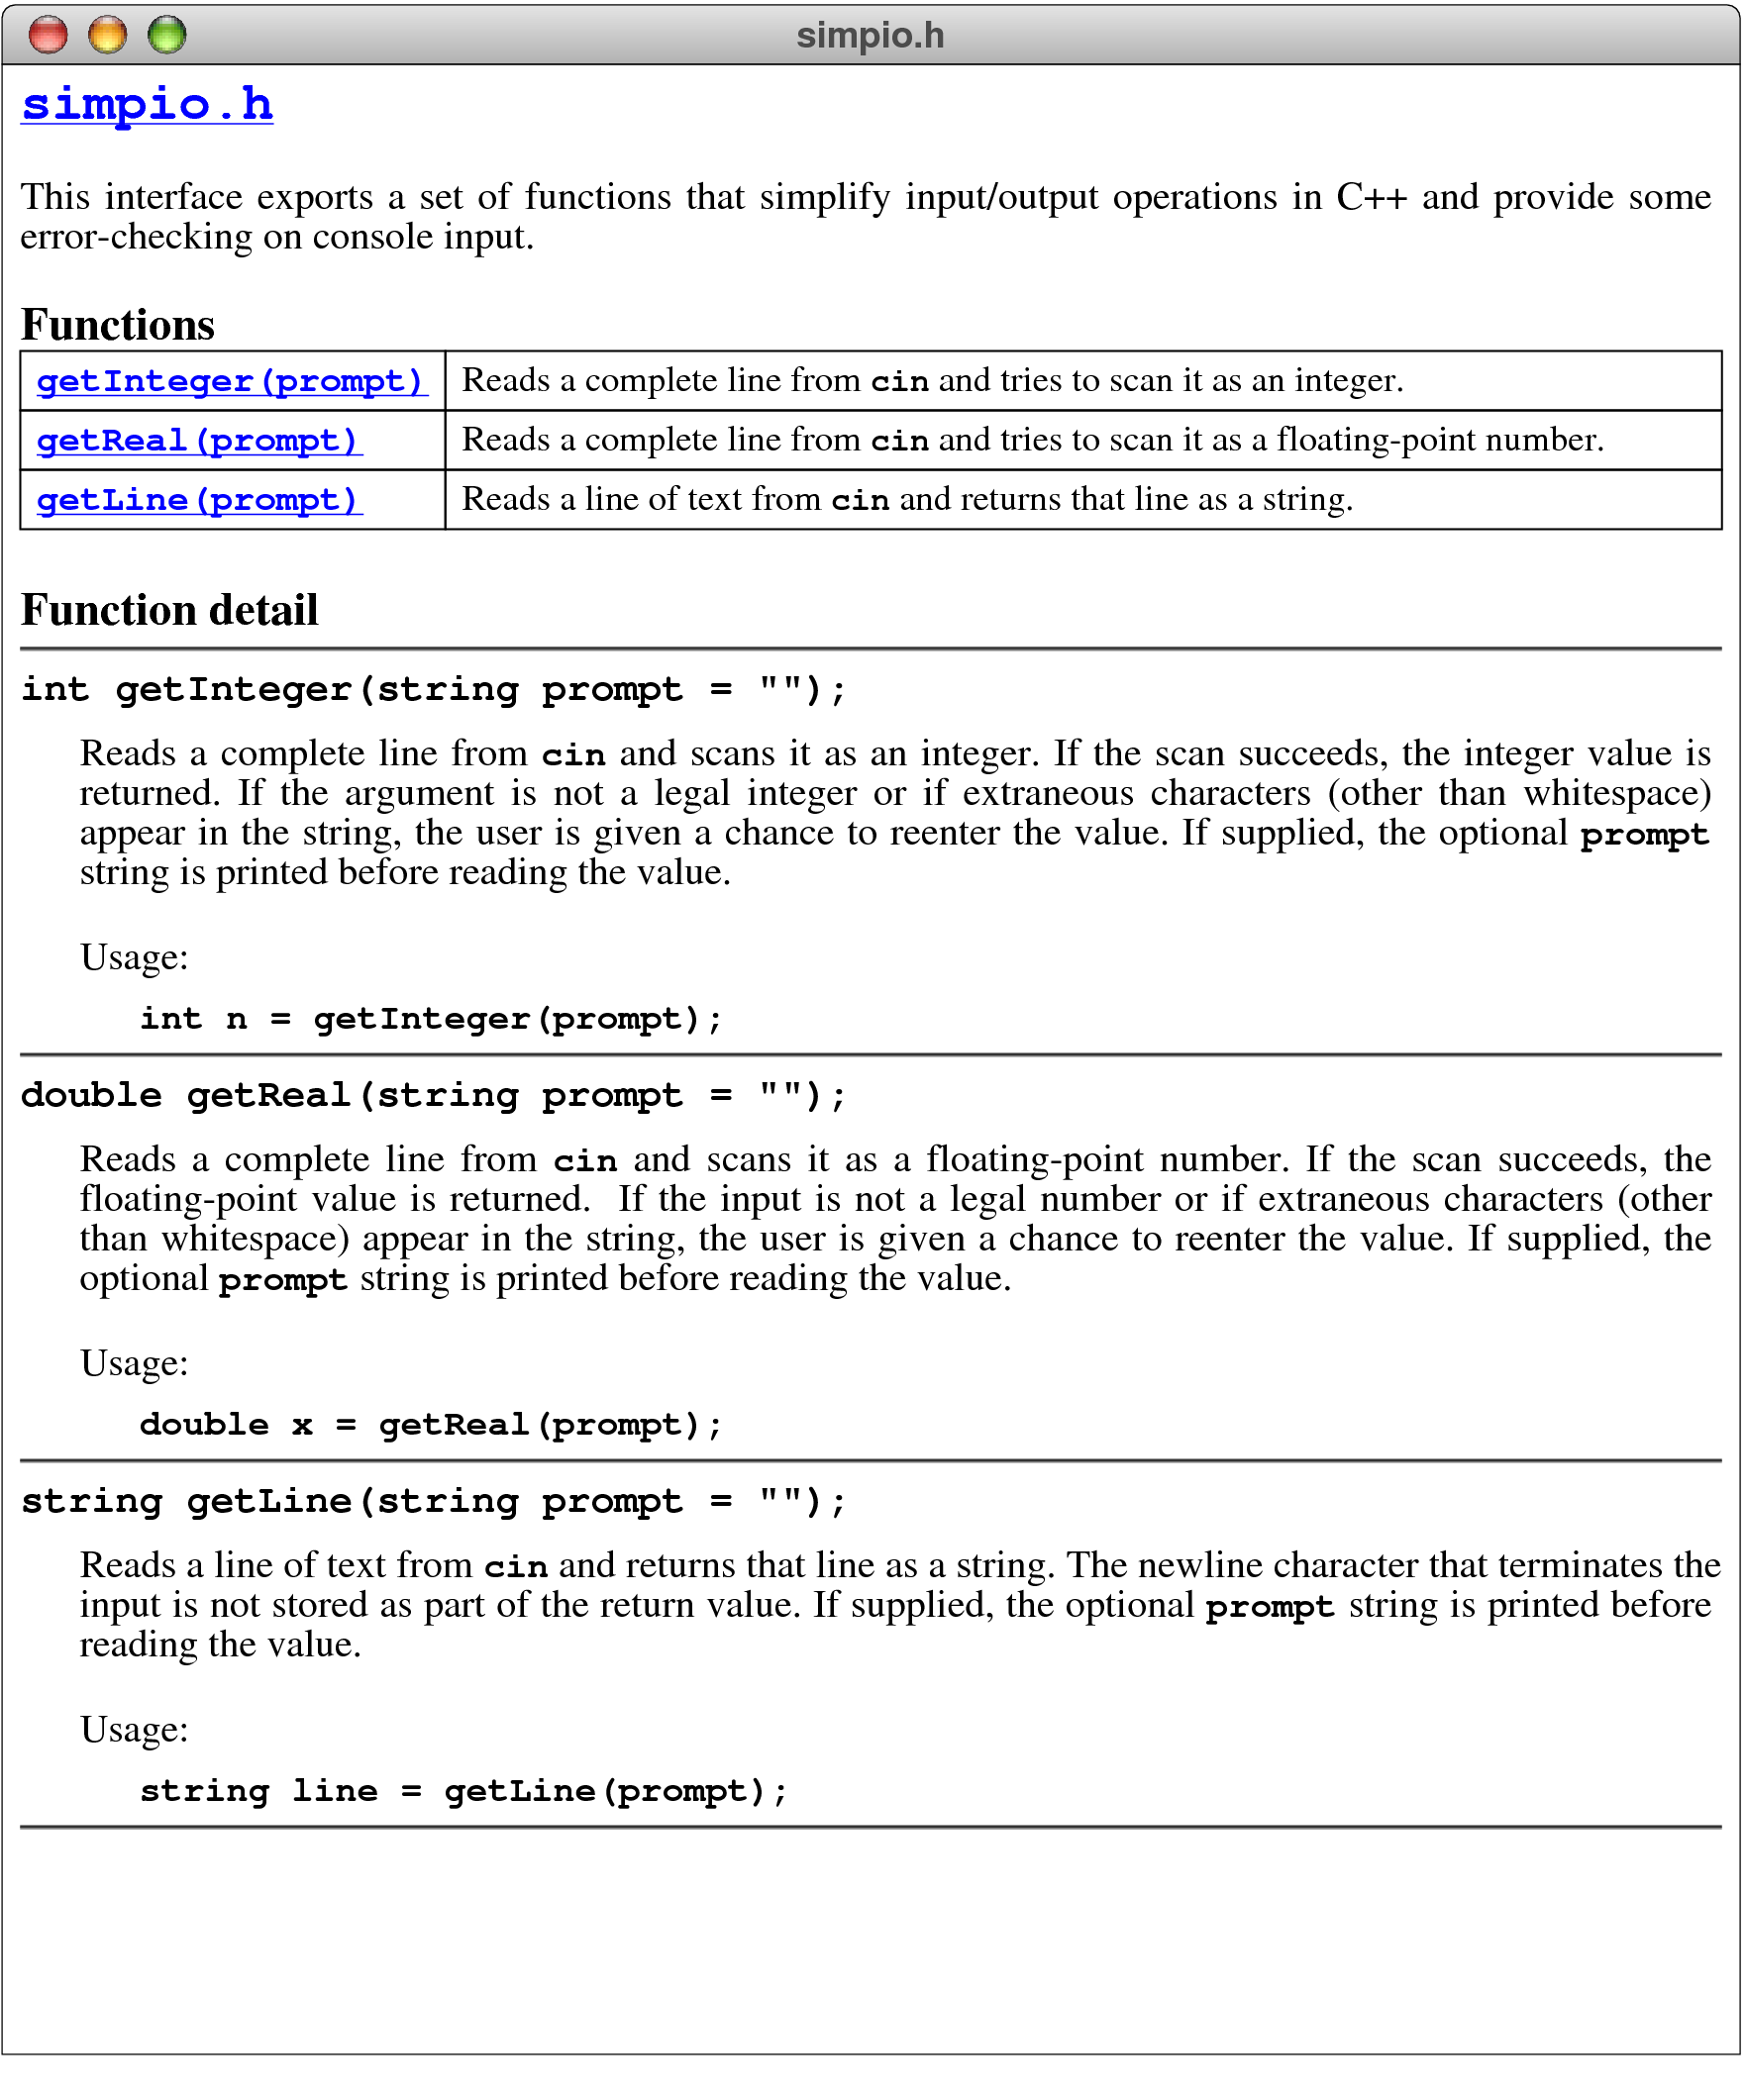
The simpio.h Interface

Slide 21
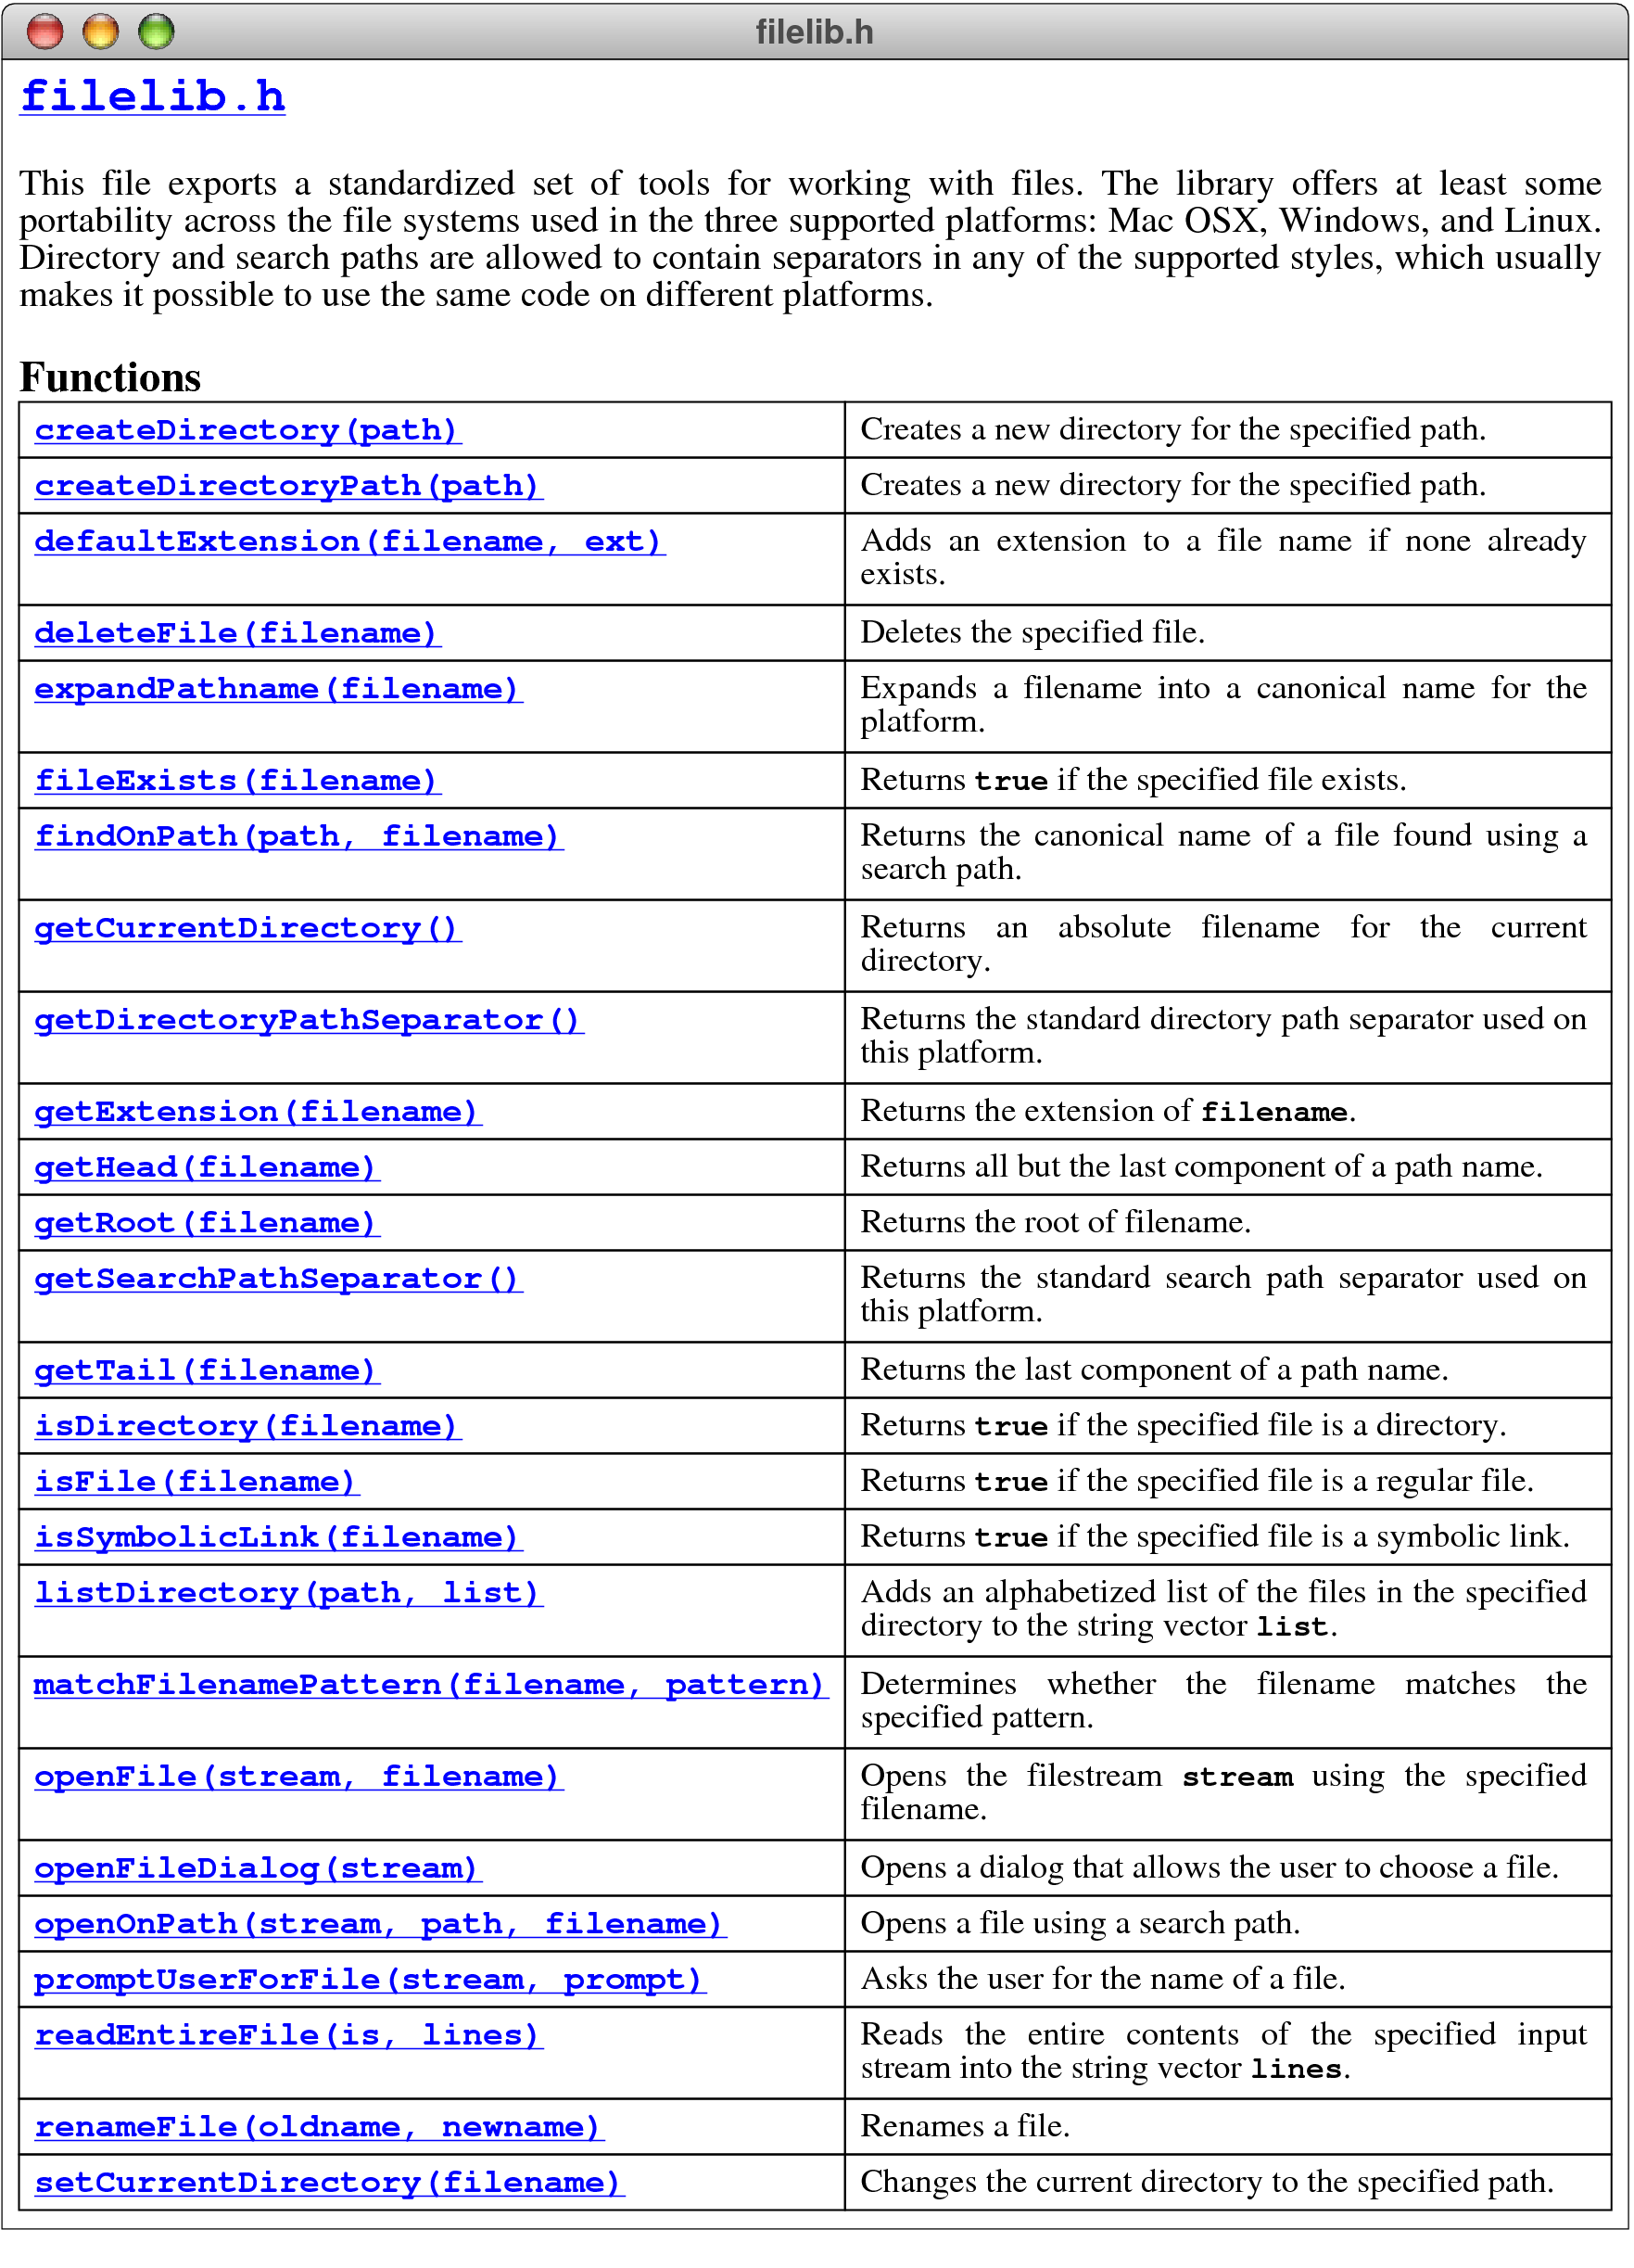
The filelib.h Interface

Slide 22
The End

